Slide 1

LINE FOLLOWER ROBOT FOR MEDICAL PURPOSES
Devipriya Nuthalapati¹, MoulikaMyneni², K.A. Sunitha³
Student^{1,2}, Associate Professor³
Department of Electronics and Communication Engineering, SRM University - AP
Department of Electronics and Communication Engineering

Slide 2
Abstract
The main motive of this project is to create a simple autonomously guided line-following robot, that follows a line drawn on the ground without any guardian. This robot is specially designed for medical purposes such as delivering medicines on time for the patients when the medical staff is not enough and the patients are full so that there won’t be any delay. The robot will give the medications to the patients by following the line. The robot will follow the time that has been set already to it and will give medications to patients from time to time. Using IR sensors the robot will detect the color of the line and follow accordingly.
Department of Electronics and Communication Engineering

Slide 3


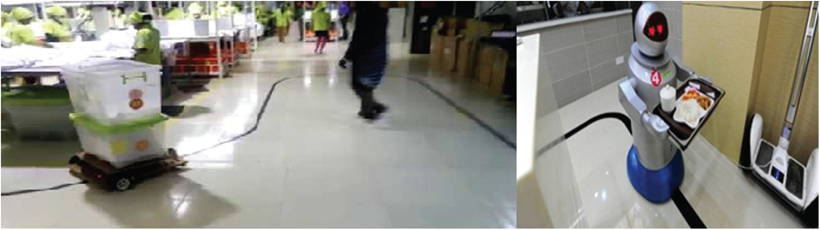
Budget in detail(with components):
INTRODUCTION
General medical services to patients:
Line follower robot medical services to patients:
pic courtesy of google
Here humans(nurses, guardians) are supplying medicines to patience physically.
The robot is supplying medicines and also needs to the patients time to time by following the line without taking any help from humans.
Department of Electronics and Communication Engineering
3

Slide 4
LITERATURE SURVEY
Reference number | Publication /patent title | Advantages | Disadvantages
[1]. | Technical Report of Building a Line Follower Robot | Simplicity of building, fit and forget system. | The robot follows a black line on a white surface.
[2]. | Automatic Guided Vehicle System. | Without any human control the vehicle will move automatically. | The robot follows a black line on a white surface.
[3]. | Evolving a line Following Robot to use in shopping center for entertainment | Attracting kids and customers. | It requires maintenance continuously.
[4]. | Development and Applications of Line following robot based health care management system | The robot will survey medicine to patients without taking any help from a human. | Robot cant help for people who are unable to move.
Novelty
The ultrasonic sensor which can sense the obstacles ahead, so that if any obstacle is present in the path of the robot it can avoid it. At some time, if the robot sensors have any problem, then we can have an application through which we can control the robot manually.
Department of Electronics and Communication Engineering

Slide 5
AIM: OBJECTIVES:
AIM: To design an autonomous guided line-following robot for medical purposes (and many more).
OBJECTIVE:
To be able to avoid any obstacles detected on the way.
To be able to reach the destination without any human guidance by following the line.
To be able to follow the timeline for giving medicines to patience.
Department of Electronics and Communication Engineering

Slide 6
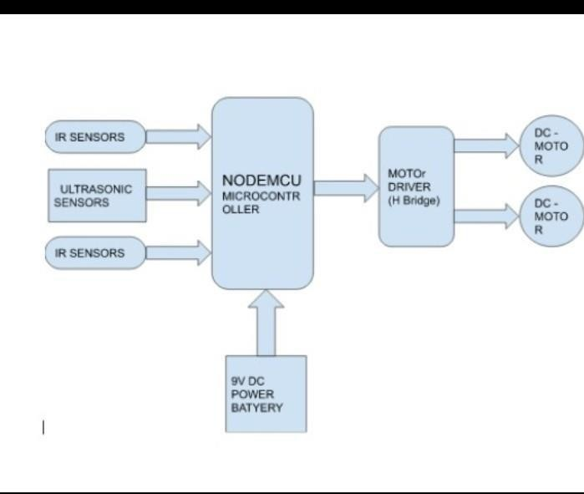
Block Diagram
BLOCK DIAGRAM
12/14/2022
Department of Electronics and Communication Engineering
6

Slide 7
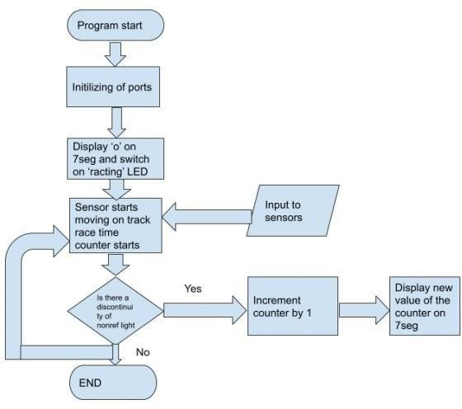
Flow chart of the Program
Department of Electronics and Communication Engineering

Slide 8
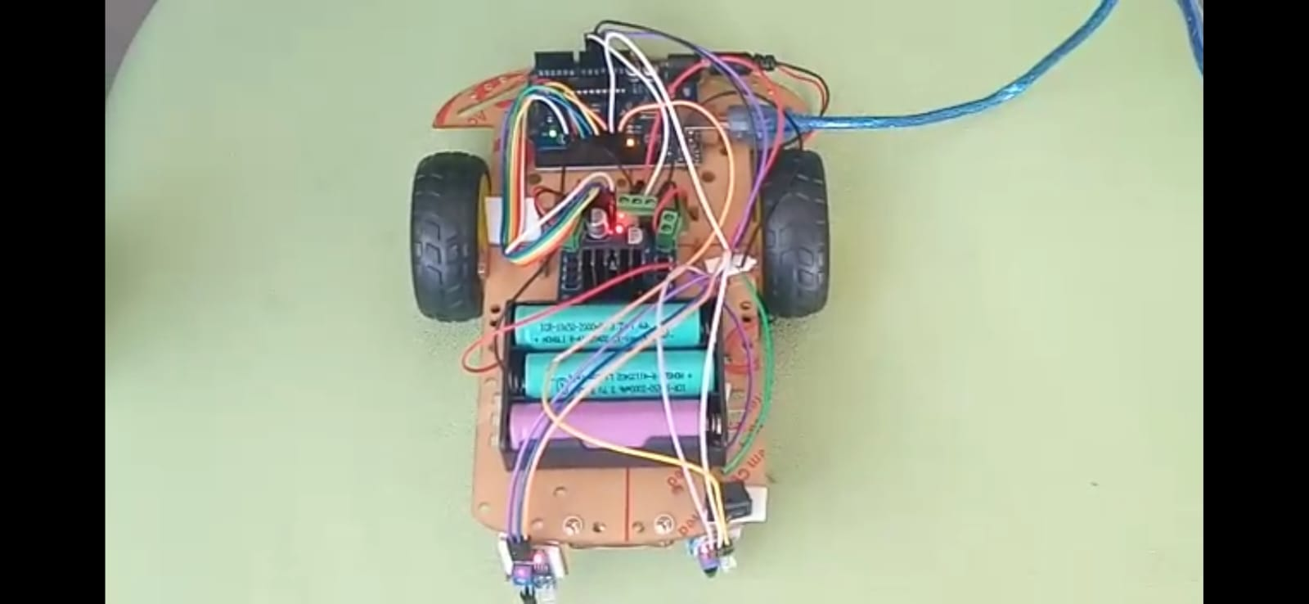
Picture of the Project with label (With neat background)
ARDUINO UNO
WHEELS WITH GEAR MOTORS
L298N MOTOR DRIVER
JUMPER WIRES
3-LI-ION BATTERIES EACH OF 3.7V AND 2A
SWITCH
2- IR SENSORS
Hyperlink of the video: https://drive.google.com/drive/folders/10S91f6UQphkSZw34JPBiCswM_TM4jicI
Department of Electronics and Communication Engineering

Slide 9
Conclusion
Finally, in this project, the robot improves the quality of the health care system it is for a country like India where there is a huge population and resources are scarce it also helps in many other ways in different industries.
Outcome of the Project
The robot follows a black line on white surface, after receiving the input values from the IR sensors. Accordingly the robot moves (right, left, forward, backward). Through the Ultrasonic sensor the robot can detect any obstacles in its path and avoid it by taking a 90 degree turn and back again to the black line. Through Bluetooth sensor the robot can also be controlled manually in case of any emergency or any faults occur with the robot.
Department of Electronics and Communication Engineering

Slide 10
References(IEEE format)
[1]. Bajestani, S.E.M., Vosoughinia, A., “Technical Report of Building a Line Follower Robot” International Conference on Electronics and Information Engineering (ICEIE 2010), vol 1, pp v1-1 v1-5, 2010.
[2]. Bong. D.M.K, “Automatic Guided Vehicle System” in Department of Electrical Engineering, University Tenega Nasional, Malaysia, P.41, 2004.
[3]. Colak, I.., Yildirim, D., “Evolving a line Following Robot to use in shopping center for entertainment”,Industrial Electronics, 2009. IECON ;09. 35th Anual Conference of IEEE,pp.3803–3807,3-5 Nov. 2009.
[4]. Development and Applications of Line following robot based health care management system deepak puneth, neeraj kumar, vartika mehta, international journal of advanced research in computer engineering & technology (IJARCET), volume 2, issue 8, August 2013 p2446-2450.
Department of Electronics and Communication Engineering

